Slide 1
Text Classification

Slide 2
Contents
Recurrent Neural Networks and LSTMs
The Problem of Authorship Attribution
The Federalist Papers Lab – Assumptions and Network Architecture

Slide 3
Recurrent Neurons
y
y_{t-1}
y_{t}
y_{t+1}
y_{t+1}
s
s_{t-1}
s_{t}
s_{t+1}
s_{t+2}
x
x_{t-1}
x_{t}
x_{t+1}
x_{t+1}
Unrolling in Time
Notes:
In the previous lab, we encountered Fully-Connected (FC) neural networks. We would either go forward (from layer i to i+1) when propagating information or backwards (from layer i+1 to i) when propagating the error. At no point did we go in a horizontal direction inside the same layer.
Often we wish to use neural networks with sequence inputs or outputs: in other words, our input/output consists of different values at different timesteps. For that, we need to use recurrent neural networks (RNNs). As shown in the example here, at each timestep we have different inputs (the X’s) and different outputs (the y’s). Additionally, we have the state from the previous timestep (the S’s) as input (with the initial state typically being the 0 vector).
The algorithm used to train RNN’s is just the usual backpropagation, applied to subsequent timesteps and hence known as Backpropagation-Through-Time (BPTT).

Slide 4
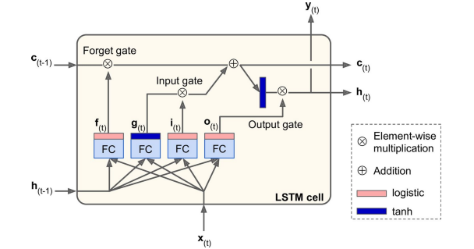
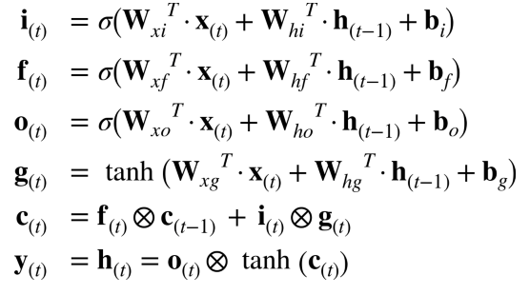
Long Short Term (LSTM) Cell
Notes:
Regular RNN’s are notoriously difficult to train. Because of the multiple timesteps, error gradients often tend to either shrink (‘vanish’) or grow (‘explode’) exponentially. This means that vanilla RNNs have difficulty with long sequences such as the ones we need for dealing with long text sequences.
A modification to the standard RNN is the Long Short-Term Memory (LSTM) cell, which overcomes many of the issues just mentioned. Essentially, it is a set of multiple neurons known as gates along with a memory cell. At each timestep, the cell receives input (x) along with the cell contents (c) and hidden state (h) from the previous timestep. The gates have the following functions:
Forget gate – what parts of the memory cell should be ‘forgotten’
Input gate – what parts of the input should be applied to the memory cell
Output gate - what parts of the memory cell should be exposed in the output of the cell
The new hidden state and memory cell state are then propagated to the next time step. The parameters are learned as usual using BPTT.

Slide 5
Authorship Attribution
Given a set of documents and a set of authors, which authors wrote which documents?
We need to learn the ‘style’ of each author: common words and phrases, sentence length, use of punctuation, etc. This is known as the science of Stylometry.
Notes:
The problem we will deal with in this lab is the problem of Authorship Attribution: given multiple documents and multiple authors, assign the correct author or authors to each document. This is known as Stylometry. There has been a lot of research done on the various features that can help us identify author style. Since we using Deep Learning, however, we will be learning specific features ourselves.

Slide 6
The Federalist Papers
Set of 85 papers written between 1787 and 1788 by Alexander Hamilton, James Madison and John Jay under a pseudonym and meant to promote the ratification of the US Constitution.
The authorship of 12 of these papers is disputed between Hamilton and Madison
We will attempt to use Deep Learning to settle the question!
Notes:
This lab will attempt to assign either Alexander Hamilton or James Madison as the author of each one of the disputed papers. We will learn the style of each author from known papers and have the network infer the author for the unknown ones.

Slide 7
Assumptions
Single author per document – either Hamilton or Madison
Author style is consistent across multiple documents
Notes:
For this lab we make the following assumptions:
There is only one author per document, and it is either Hamilton or Madison. In practical terms, this means that we ignore the papers written by John Jay, and do not take into account an ‘unknown’ author or a collaboration between Hamilton and Madison.
The author’s style is consistent across all documents and does not change with time, topic, etc.

Slide 8
Network Architecture
AH or JM
Classifier
FC
Style Vector
Style Extractor
LSTM
Character Embeddings
FC
Input Sequence
Notes:
Network architecture is as follows:
We break each document down into multiple character sequences and label them with the author of the document. The reason for this is that we have a small corpus of relatively short documents, so training a language model on words is likely to overfit. We therefore use character sequences as our inputs so we have hundreds of thousands of such sequences. Note that our preprocessing of input data lowercases the text but retains punctuation as these are important for determining author style.
We learn embeddings for each character. This may seem counter-intuitive: we actually increase the dimensionality of our input! However, as we saw in the previous lab, embeddings learn useful features from the domain. In this case, these features apply directly to the author style we’re looking for.
We proceed by feeding the (embedded) character sequence to an LSTM cell. This is where we do the actual learning of style features. We take the output of the final timestep of the LSTM Style Extractor as our output (discarding all previous timesteps) and treat it as an encoding of the style of the sequence. We will also look at a 2-D representation of these vectors – if our network does a good job, we will see a distinct clustering of AH vs. JM vectors.
Finally, we feed the style vector into a multi-layer, fully-connected classifier that outputs AH or JM as output. We compare this output with the ground-truth during training for determining the error. During inference, we count the number of AH/JM sequences, and the ‘winner’ is considered to be the author of the disputed document.

Slide 9
Summary
RNNs may be used for training on sequences – LSTMs provide an easy-to-train variant
We use LSTMs to learn and encode the style of character sequences from the Federalist Papers
We determine the author of a document by determining which author has written more sequences in a disputed Federalist Papers document

